Slide 1
Ripples in Graphene via Molecular Dynamics Simulation by
Santosh M, Santhosh D, Vikram Rathee

Slide 2
Overview
Stability
Electronic structure of graphene
Ripples
Motivation
Our Work

Slide 3
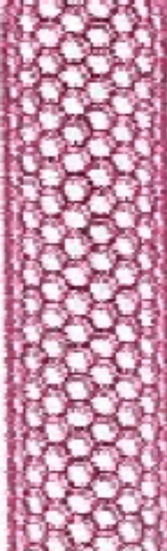

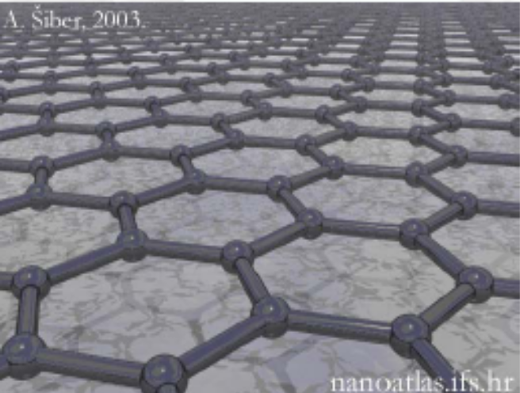
Carbon Allotropes
Graphite
Graphene
Carbon nanotube

Slide 4
Stability :2D crystal exist ?
Mermin–Wagner theorem :
Strictly 2D crystal are thermodynamically unstable.
Graphene is a one atom thick sheet of carbon that was
isolated for the first time in 2004.
Electrons in graphene move at an effective speed of light
300 time less than the speed of light in vacuum.
The electrons in graphene can travel large distances with
out being scattered (300nm).
Mermin,N.D.Crystalline order in 2D Physical Rev.176,250(1968)

Slide 5
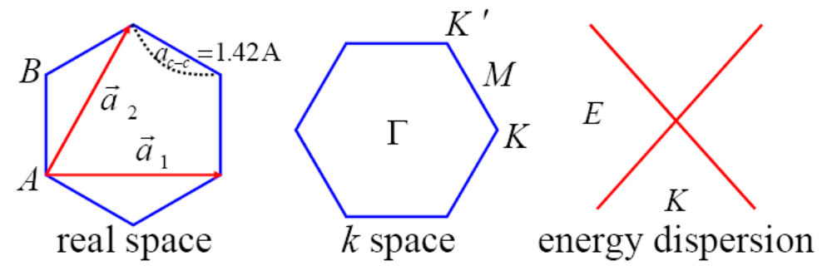
Electronic Structure:
sp hybridization form strong directed bonds which determines a honeycomb lattice structure
The energy band of graphene at low energy are described by 2D Dirac-like equation
2
Pz orbital determines the conduction properties of graphene
K.S.Novoslov,A.K.Geim,Nature ,438,10(2005)

Slide 6
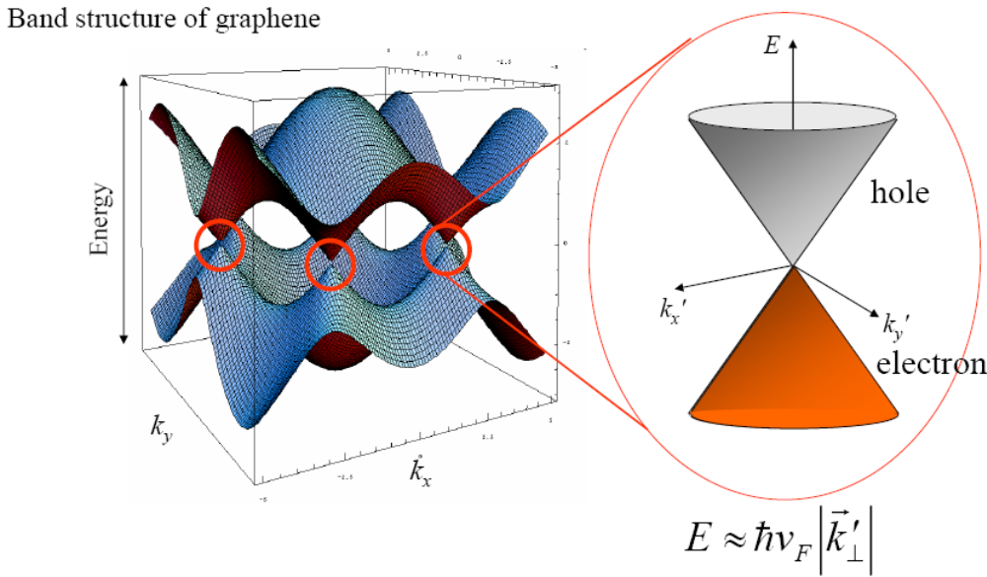
Physics Today (2006)

Slide 7
Suspended structure of graphene:
TEM reveals that suspended graphene sheets are
not perfectly flat.
Ripples
Monolayer graphene in reciprocal space has only the
zero-order Laue zone.
Diffraction peaks becomes broader with increasing tilt
angle
Broadening becomes notably weaker in bilayer samples
J.C.Mayer, A.K.Geim ,Nature,446,60 (March 2007)

Slide 8
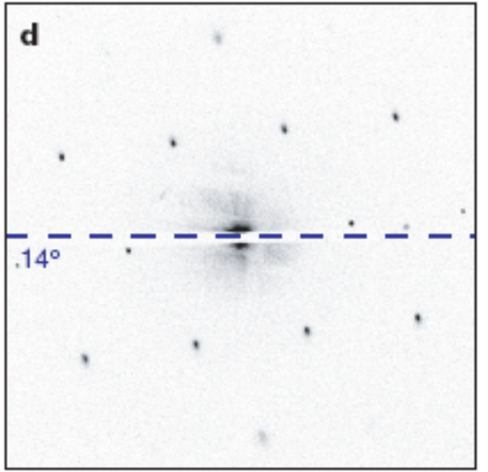
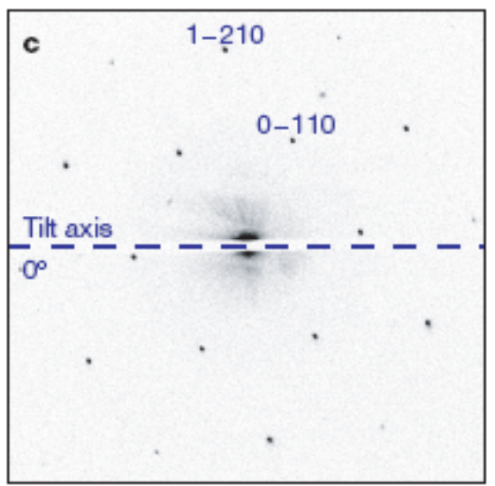
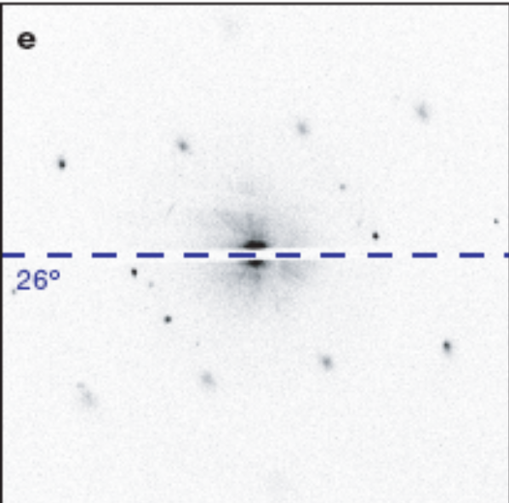
Intensity at different Incident angles

Slide 9
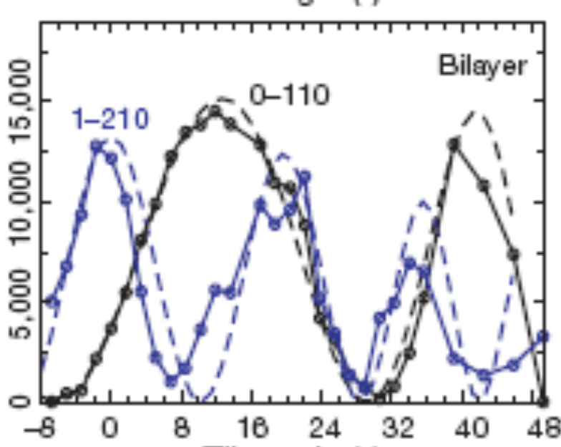
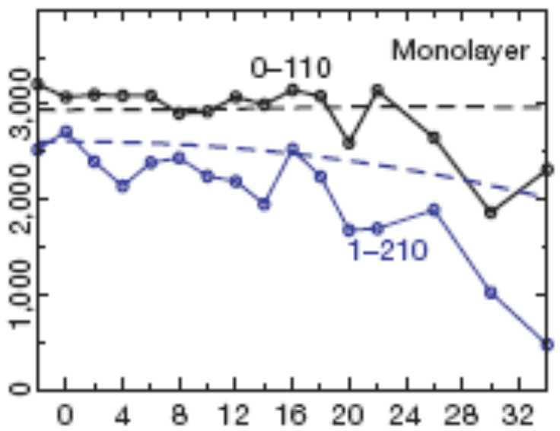
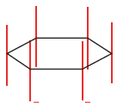
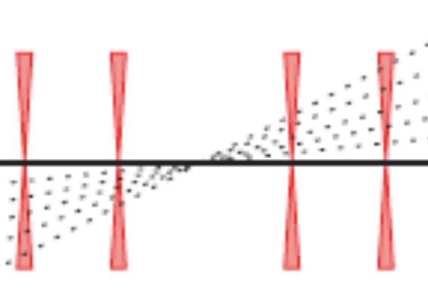
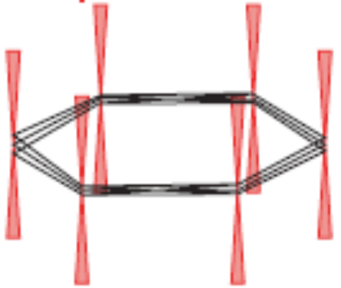
Intensity
Intensity
Tilt angle
Tilt angle

Slide 10
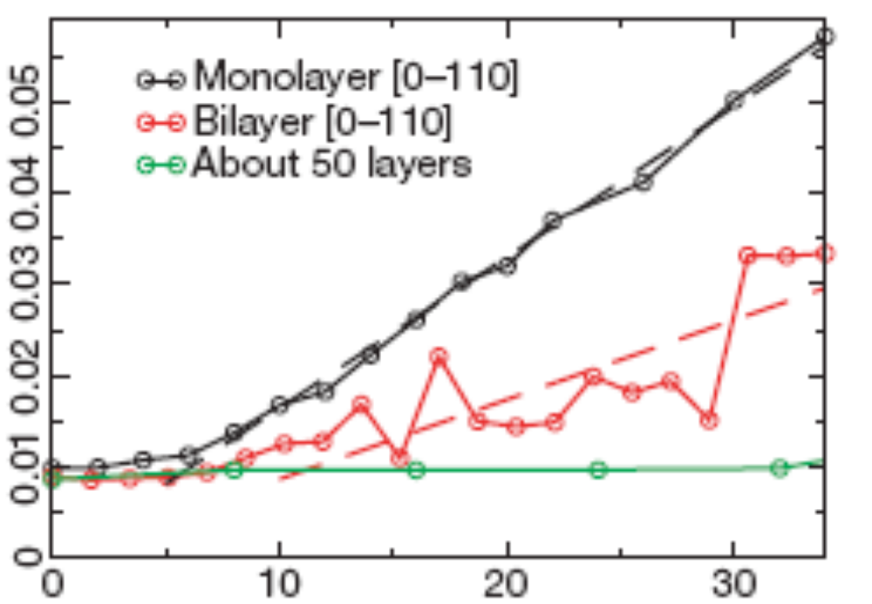
FWHM
Tilt angle

Slide 11
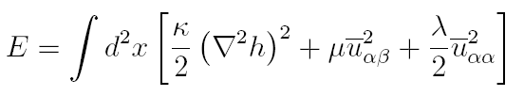

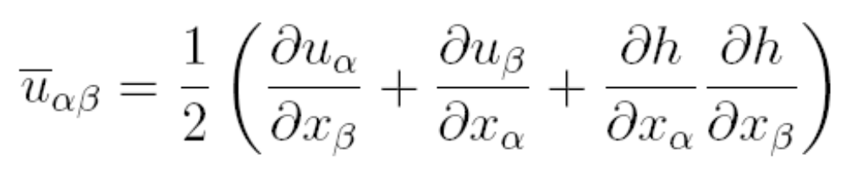
Motivation:
Fluctuation wavelength in 2D crystal can be suppressed
by anharmonic coupling between bending and stretching
modes making that a 2D crystal can exist but should
present strong height fluctuation.
Elastic energy of membrane is
u  is deformation tensor 
Saffron ‘Statistical mechanics of membrane’

Slide 12
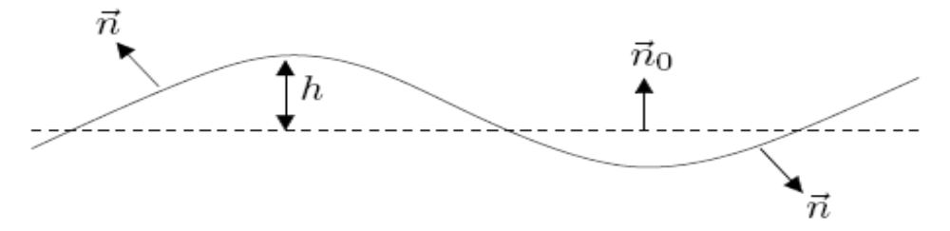
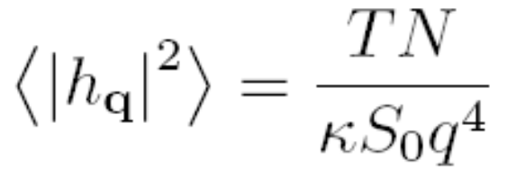
e(h(x,y)) = (e(h(x,y)) – e(0)) A
Bending correlation function with wave vector q
Live Rekvig, Berend Smit, JCP,120,10(2004)

Slide 13
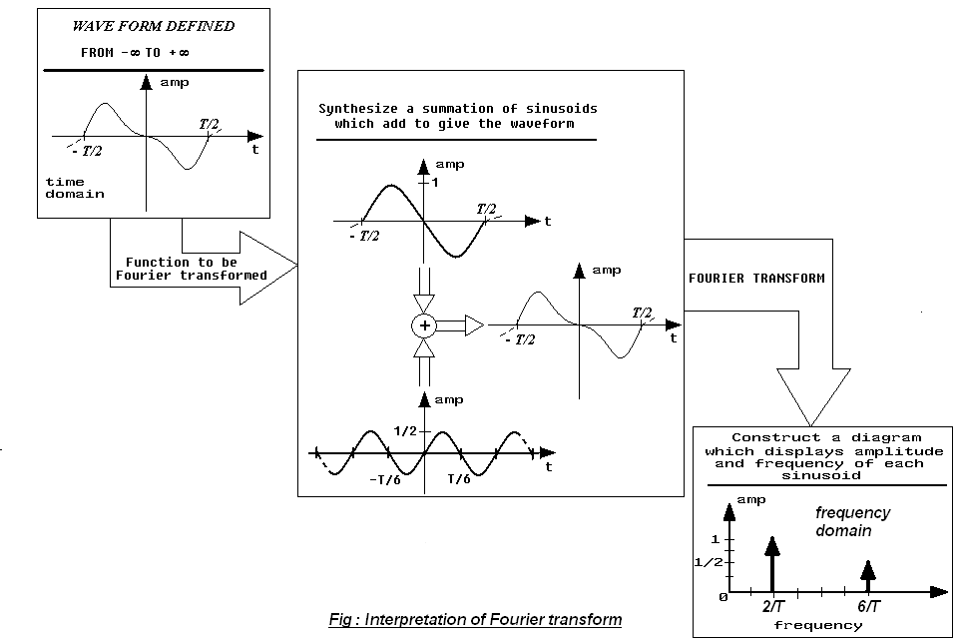
Fourier Transform
Fourier Transform of a wave form is to decompose or separate the waveform into a sum of sinusoids of different frequencies.
If these sinusoids sum to the original waveform, then we have determined the Fourier transform of the waveform.

Slide 14

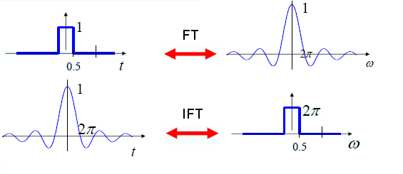
FT and IFT Conti….
Mathematically 1-D FT and its inverse FT are:
Some illustrations

Slide 15
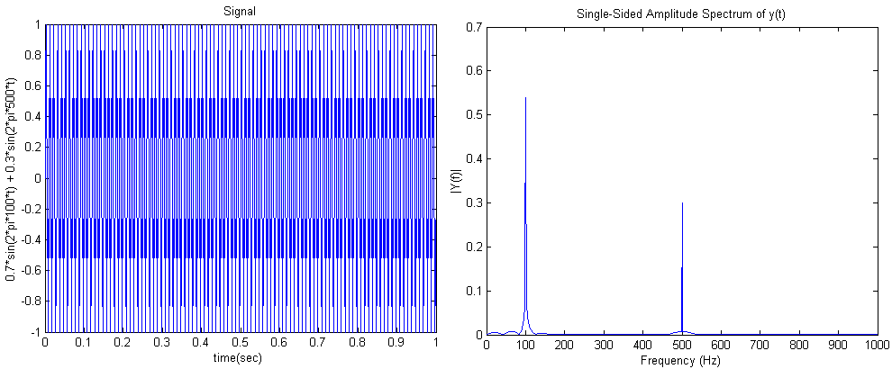
Illustration again..

Slide 16
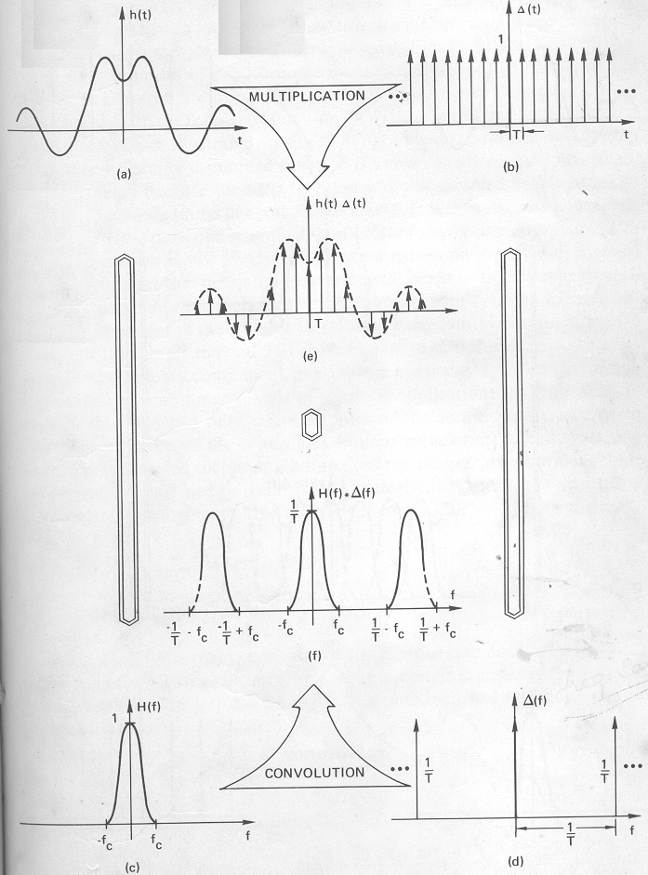
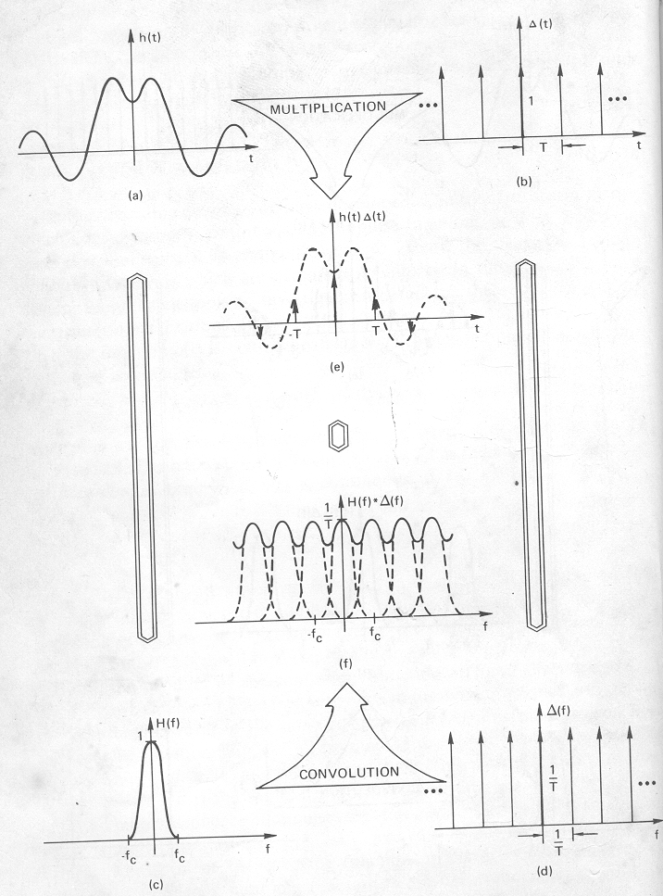
Discrete Fourier Transform or Finite FT
Sampling waveform arises due to discrete readings from experimental devices or by any means of data.

Slide 17

DFT, Aliasing, Nyquist sampling rate, FFT
The sequence of N complex numbers x₀, ..., x_{N−1} is transformed into the sequence of N complex numbers X₀, ..., X_{N−1} by the DFT according to the formula:
The efficient algorithm to calculate DFT is Fast FT.
Aliasing – the distortion of the desired FT of a sampled function
Nyquist criteria for sampling – Aliasing could be avoided if
  Band width of the frequency is evident in frequency domain. i.e.,
  FT of the Sampled function be zero for frequency greater than fc
  Sampling spacing be chosen as 1/T = 2 f_{c}.
Fast Fourier Transform and Its Applications , E Oran Bringham

Slide 18
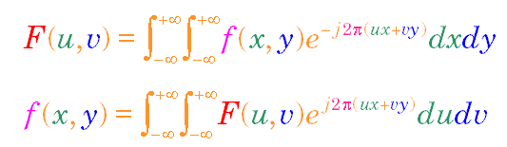
2-Dimensional FT
Mathematically 2-D FT is written as
The Fourier transform can be applied to 2 dimensional signals, e.g. images.
u and v are equivalent to reciprocal wavelength (wave-number/(2 pi)).

Slide 19
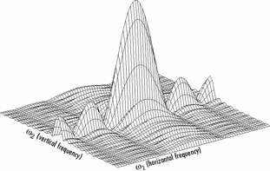
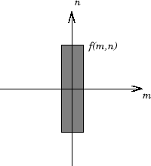
2-D FT, DFT
Graphical representation of 2-D FT
Equivalently Discrete Fourier Transform is represented as

Slide 20
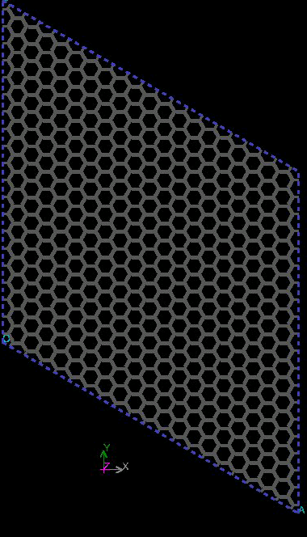
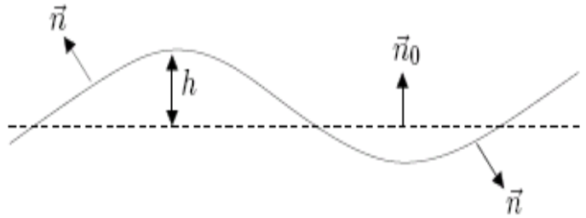



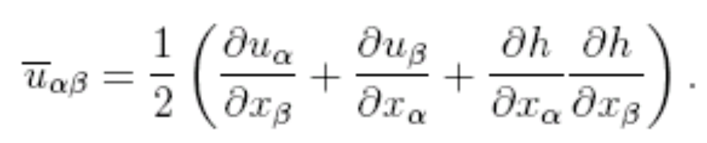
Graphene, the first truly 2D crystal
Prime Motivation – Determine bending rigidity κ of Graphene sheet by molecular simulation
The elastic energy of the graphene membrane is given by
In harmonic approximation, by neglecting the last, non linear, term in the deformation tensor, the bending (h) and stretching (u) modes are decoupled.
A . Fasolino, J.H. Los, Intrinsic ripples in graphene.

Slide 21
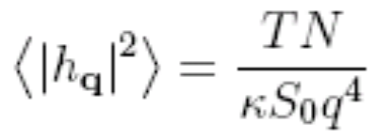

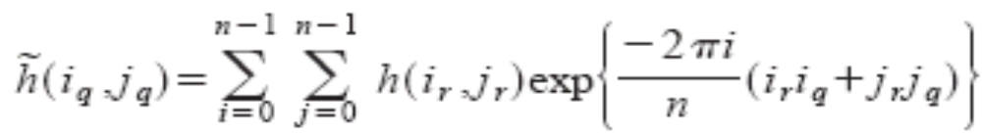

The bending correlation function and hence κ
With decoupled approximation the Fourier components of the bending correlation function with wave vector q is
The 2-D DFT of bending correlation function can be written as
Averaging over all snapshots we can obtain for
After statistical averaging get κ for a given temperature.
Live Rekvig, Simulating the effect of surfactant structure on bending moduli of
monolayers, journal of chemical physics, V.120, 10, 4897- 4905

Slide 22

Method and implementation
For an efficient Fourier Transform, we need to have large number of data points.
One way is to interpolate h(x,y) is to introduce a grid.
Where rk ²= (xk -∆i)² + (yk - ∆j)² within a cutoff R
After optimisation, we took p = 4 and R = 1 A°

Slide 23
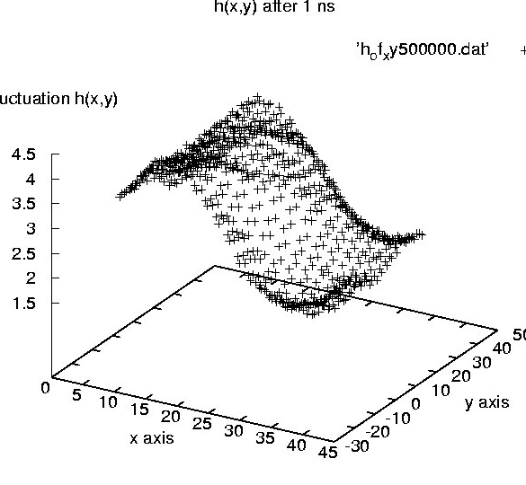
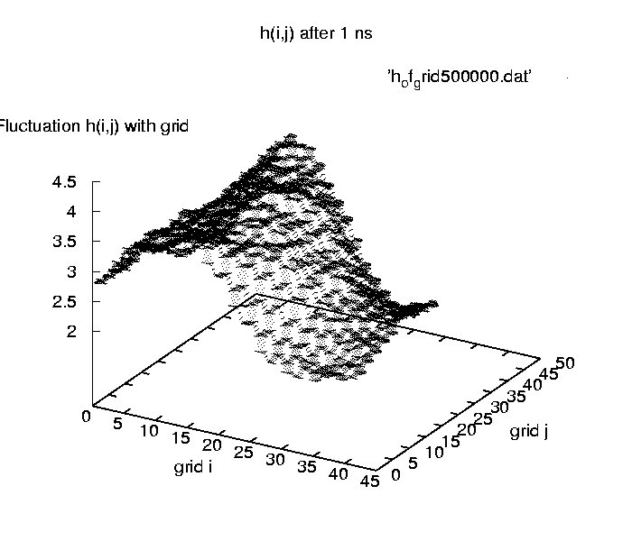
Fluctuation h(x,y)
Fluctuation h(i,j) with grid

Slide 24
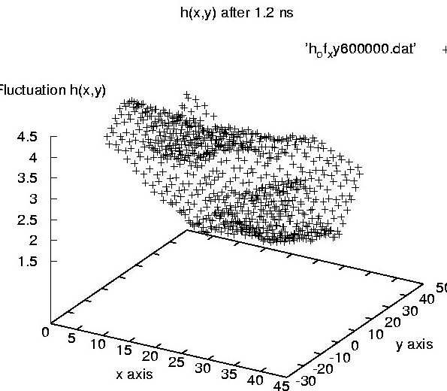
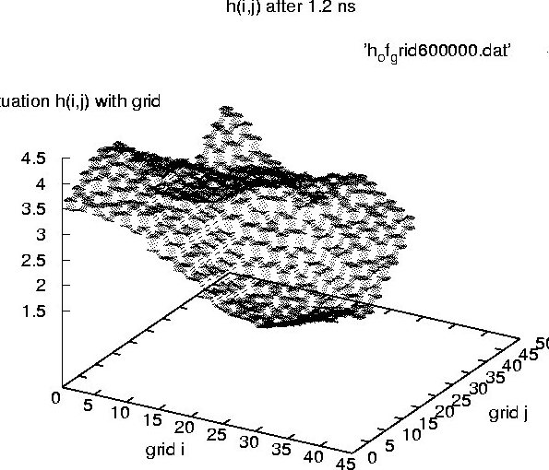
Fluctuation h(x,y)
Fluctuation h(i,j) with grid

Slide 25
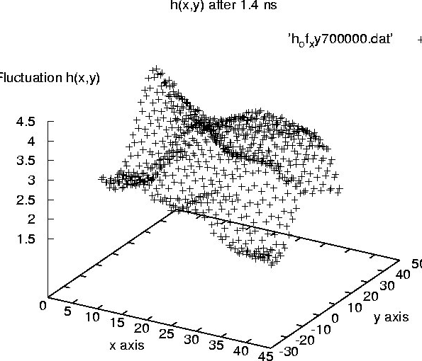
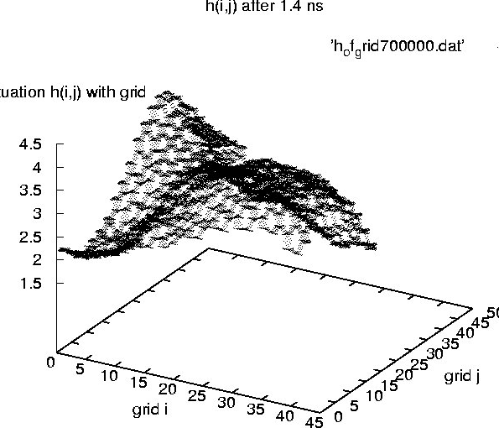
Fluctuation h(i,j) with grid
Fluctuation h(x,y)

Slide 26
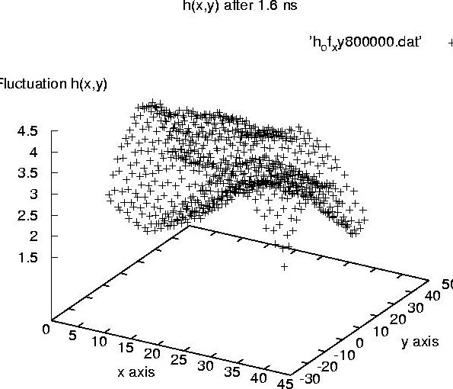
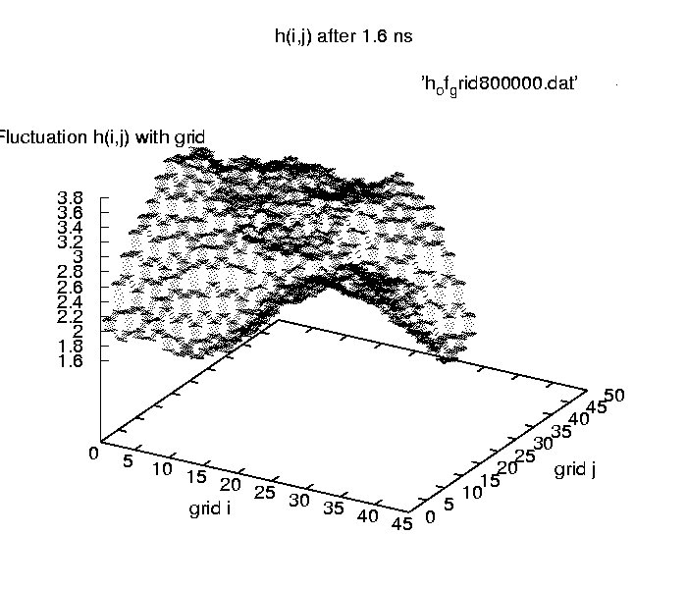
Fluctuation h(x,y)
Fluctuation h(i,j) with grid

Slide 27
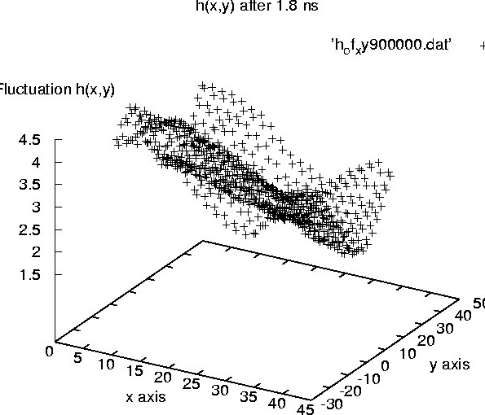
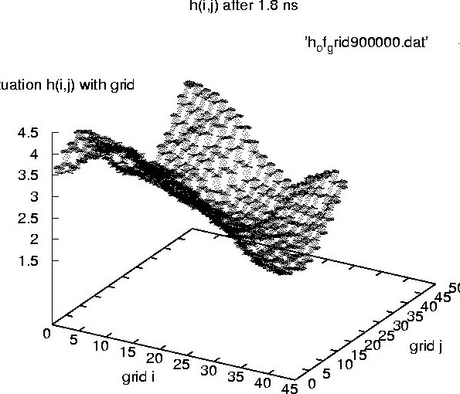
Fluctuation h(x,y)
Fluctuation h(i,j) with grid

Slide 28
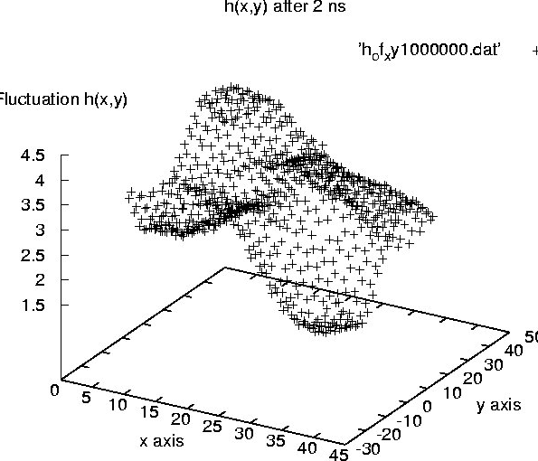
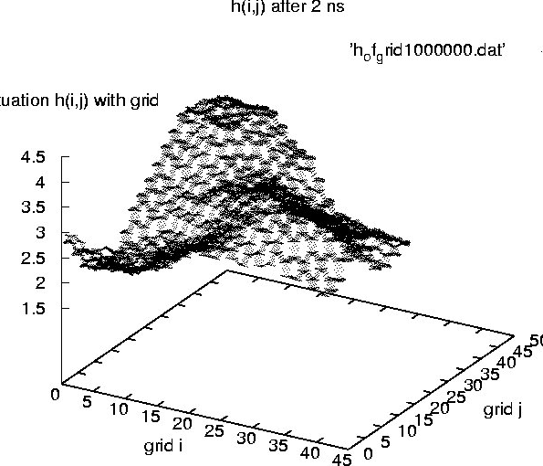
Fluctuation h(x,y)
Fluctuation h(i,j) with grid

Slide 29

Crux of the matter
FOURIER TRANSFORM
We are aiming to take FOURIER TRANSFORM

Slide 30
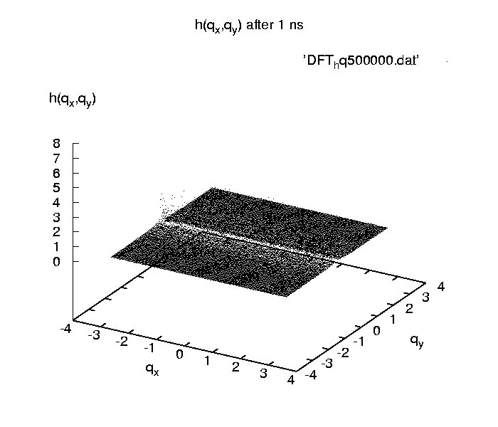

Slide 31
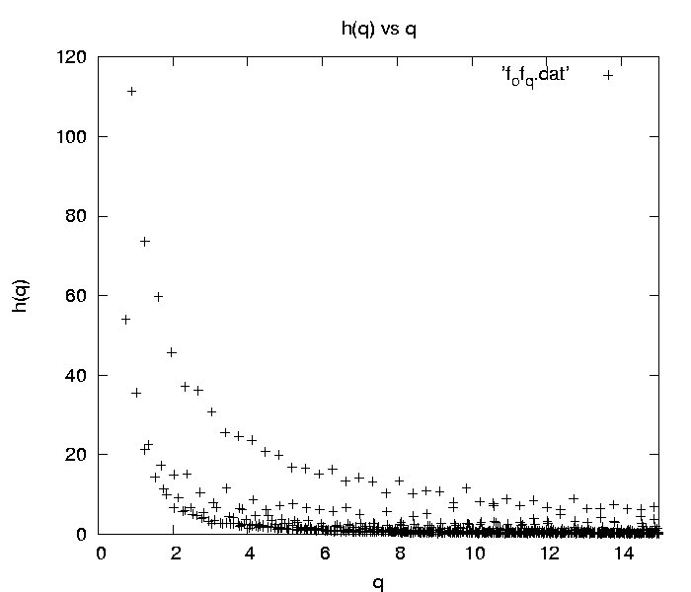
Fourier Transform of h(i,j) after 1.75 ns

Slide 32
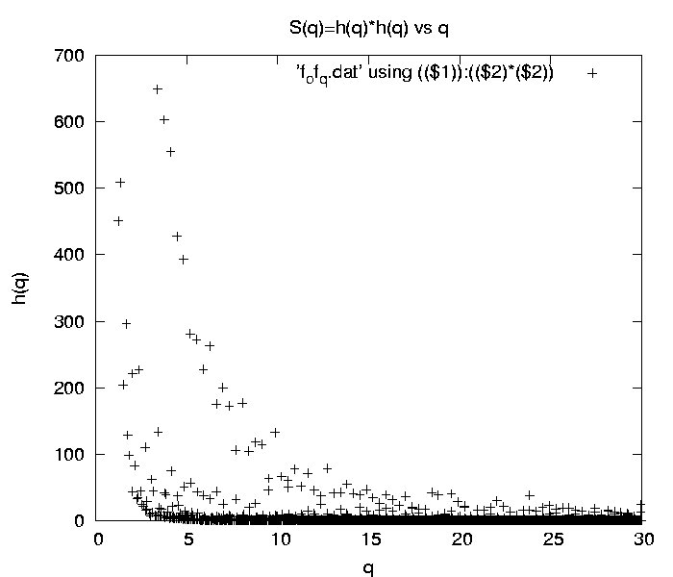
Structure Factor after 1.75 ns
S(q)

Slide 33
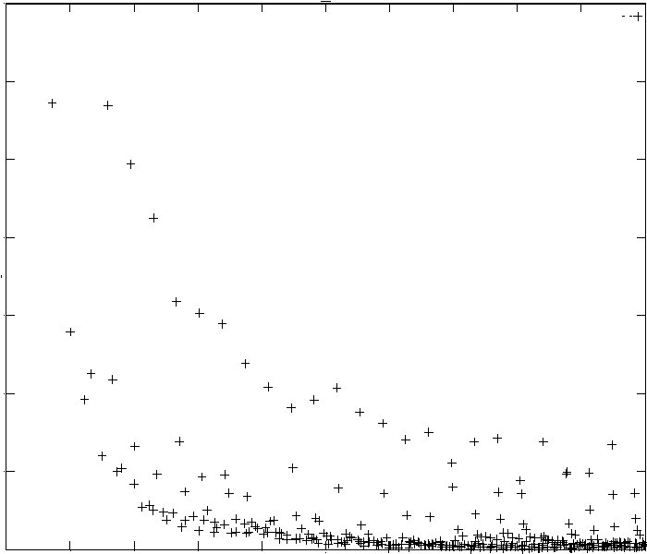
Fourier Transform of h(i,j) after 2 ns
f(q)
(0-70)
q (0-10) A⁻¹

Slide 34
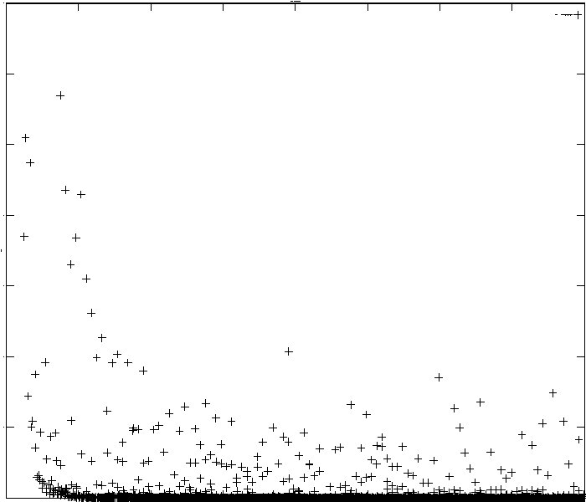
Structure Factor after 2 ns
S(q)
0-700
q (0 – 20) A⁻¹

Slide 35
Thanks to
Prabal K Maiti
Kakali Sen
Usha Rani D
Dasari LVK Prasad

